Slide 1
DATA MINING AND DATA WAREHOUSING-Module 2

Slide 2
Module II
Data Preprocessing Concepts
Data Cleaning
Data integration and transformation
Data Reduction
Discretization and concept hierarchy.

Slide 3
Why Data Preprocessing?
Data in the real world is dirty
incomplete: lacking attribute values, lacking certain attributes of interest, or containing only aggregate data
e.g., occupation=“ ”
noisy: containing errors or outliers
e.g., Salary=“-10”
inconsistent: containing discrepancies in codes or names
e.g., Age=“42” Birthday=“03/07/1997”
e.g., Was rating “1,2,3”, now rating “A, B, C”
e.g., discrepancy between duplicate records

Slide 4
Why Is Data Dirty?
Incomplete data may come from
“Not applicable” data value when collected
Different considerations between the time when the data was collected and when it is analysed.
Human/hardware/software problems
Noisy data (incorrect values) may come from
Faulty data collection instruments
Human or computer error at data entry
Errors in data transmission
Inconsistent data may come from
Different data sources
Functional dependency violation (e.g., modify some linked data)
Duplicate records also need data cleaning

Slide 5
Why Is Data Preprocessing Important?
No quality data, no quality mining results!
Quality decisions must be based on quality data
e.g., duplicate or missing data may cause incorrect or even misleading statistics.
Data warehouse needs consistent integration of quality data
Data extraction, cleaning, and transformation comprises the majority of the work of building a data warehouse

Slide 6
Major Tasks in Data Preprocessing
Data cleaning
Fill in missing values, smooth noisy data, identify or remove outliers, and resolve inconsistencies
Data integration
Integration of multiple databases, data cubes, or files
Data transformation
Normalization and aggregation
Data reduction
Obtains reduced representation in volume but produces the same or similar analytical results
Data discretization
Part of data reduction but with particular importance, especially for numerical data

Slide 7
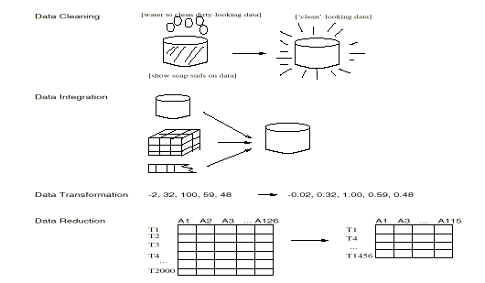
Forms of data preprocessing

Slide 8
Module II
Data Preprocessing Concepts
Data Cleaning
Data integration and transformation
Data Reduction
Discretization and concept hierarchy.

Slide 9
Data Cleaning
Importance
“Data cleaning is one of the three biggest problems in data warehousing”—Ralph Kimball
“Data cleaning is the number one problem in data warehousing”—DCI survey
Data cleaning tasks
Fill in missing values
Identify outliers and smooth out noisy data
Correct inconsistent data
Resolve redundancy caused by data integration

Slide 10
Missing Data
Data is not always available
E.g., many tuples have no recorded value for several attributes, such as customer income in sales data
Missing data may be due to
equipment malfunction
inconsistent with other recorded data and thus deleted
data not entered due to misunderstanding
certain data may not be considered important at the time of entry
not register history or changes of the data
Missing data may need to be inferred.

Slide 11
How to Handle Missing Data?
Ignore the tuple:
usually done when class label is missing (assuming the tasks in classification—not effective when the percentage of missing values per attribute varies considerably.
Fill in the missing value manually: tedious + infeasible?
Use a global constant to fill in the missing value:
e.g., “unknown”, a new class?!
Use the attribute mean to fill in the missing value:
For example, suppose that the average income of AllElectronics customers is $56,000. Use this value to replace the missing value for income.

Slide 12
How to Handle Missing Data? Contd…
Use the attribute mean for all samples belonging to the same class as the given tuple:
For example, if classifying customers according to credit risk, replace the missing value with the average income value for customers in the same credit risk category as that of the given tuple.
Use the most probable value to fill in the missing value
This may be determined with regression, inference-based tools using a Bayesian formalism, or decision tree induction.

Slide 13
Noisy Data
Noise: random error or variance in a measured variable
Incorrect attribute values may due to
faulty data collection instruments
data entry problems
data transmission problems
technology limitation
inconsistency in naming convention
Other data problems which requires data cleaning
duplicate records
incomplete data
inconsistent data

Slide 14
How to Handle Noisy Data?
Binning
First sort data and partition into (equal-frequency) bins then one can smooth by bin means, smooth by bin median, smooth by bin boundaries, etc.
Regression
Smooth by fitting the data into regression functions
Clustering
Detect and remove outliers
Combined computer and human inspection
Detect suspicious values and check by human (e.g., deal with possible outliers)

Slide 15
Binning Methods for Data Smoothing
Sorted data for price (in dollars): 4, 8, 9, 15, 21, 21, 24, 25, 26, 28, 29, 34
* Partition into equal-frequency (equi-depth) bins:
- Bin 1: 4, 8, 9, 15
- Bin 2: 21, 21, 24, 25
- Bin 3: 26, 28, 29, 34
* Smoothing by bin means:
- Bin 1: 9, 9, 9, 9
- Bin 2: 23, 23, 23, 23
- Bin 3: 29, 29, 29, 29
* Smoothing by bin boundaries:
- Bin 1: 4, 4, 4, 15
- Bin 2: 21, 21, 25, 25
- Bin 3: 26, 26, 26, 34

Slide 16
Module II
Data Preprocessing Concepts
Data Cleaning
Data integration and transformation
Data Reduction
Discretization and concept hierarchy.

Slide 17
Data Integration
Data integration:
combines data from multiple sources
Schema integration
integrate metadata from different sources
Entity identification problem: identify real world entities from multiple data sources, e.g., A.cust-id ≡ B.cust-number
Detecting and resolving data value conflicts
for the same real world entity, attribute values from different sources are different, e.g., different scales, metric vs. British units
Removing duplicates and redundant data

Slide 18
Redundancy and Correlation Analysis
Redundancy is another important issue in data integration. An attribute (such as annual revenue may be redundant if it can be “derived” from another attribute or set of attributes.
Inconsistencies in attribute or dimension naming can also cause redundancies in the resulting data set

Slide 19
Correlation Analysis
Some redundancies can be detected by correlation analysis.
Given two attributes, such analysis can measure how strongly one attribute implies the other, based on the available data

Slide 20
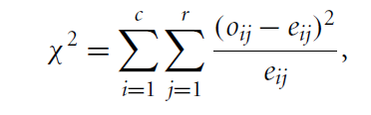
X² Correlation Test for Nominal Data
For nominal data, a correlation relationship between two attributes, A and B, can be discovered by a chi-square test.
Suppose A has c distinct values, namely a1,a2, : : :ac B has r distinct values, namely b1,b2, : : :br . The data tuples described by A and B can be shown as a contingency table, with the c values of A making up the columns and the r values of B making up the rows.
X² Value is also known as the Pearson X² statistic.

Slide 21
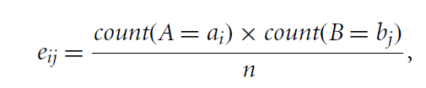
Note that the cells that contribute the most to the 2 value are those for which the actual count is very different from that expected

Slide 22

Example
Suppose that a group of 1500 people was surveyed. The gender of each person was noted. Each person was polled as to whether his or her preferred type of reading material was fiction or nonfiction. Thus, we have two attributes, gender and preferred reading. The observed frequency (or count)of each possible joint event is summarized in the contingency table shown in Table where the numbers in parentheses are the expected frequencies.

Slide 23
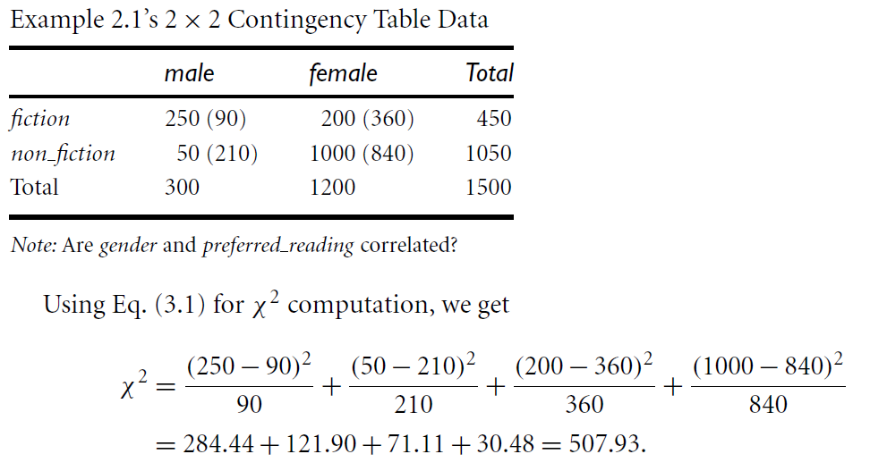

Slide 24
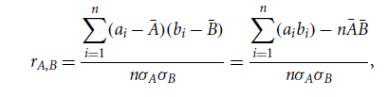
Correlation Coefficient for Numeric Data
We can evaluate the correlation between two attributes, A and B, by computing the correlation coefficient or Pearson’s product moment coefficient
n is the number of tuples
and bi are the respective values of A and B in tuple I
A and NB are the respective mean values of A and B,
sigmaA and sigmaB are the respective standard deviations of A and B
rA,B if positive positively correlated, if negative negatively correlated, 0 independent

Slide 25
Tuple Duplication
In addition to detecting redundancies between attributes, duplication should also be detected at the tuple level
The use of denormalized tables (often done to improve performance by avoiding joins) is another source of data redundancy.
Inconsistencies often arise between various duplicates, due to inaccurate data entry or updating some but not all data occurrences.

Slide 26
Data Value Conflict Detection and Resolution
Data integration also involves the detection and resolution of data value conflicts.
This may be due to differences in representation, scaling, or encoding

Slide 27
Data Transformation
Smoothing: remove noise from data
Normalization: scaled to fall within a small, specified range
Attribute/feature construction
New attributes constructed from the given ones
Aggregation: summarization
Generalization: concept hierarchy climbing

Slide 28
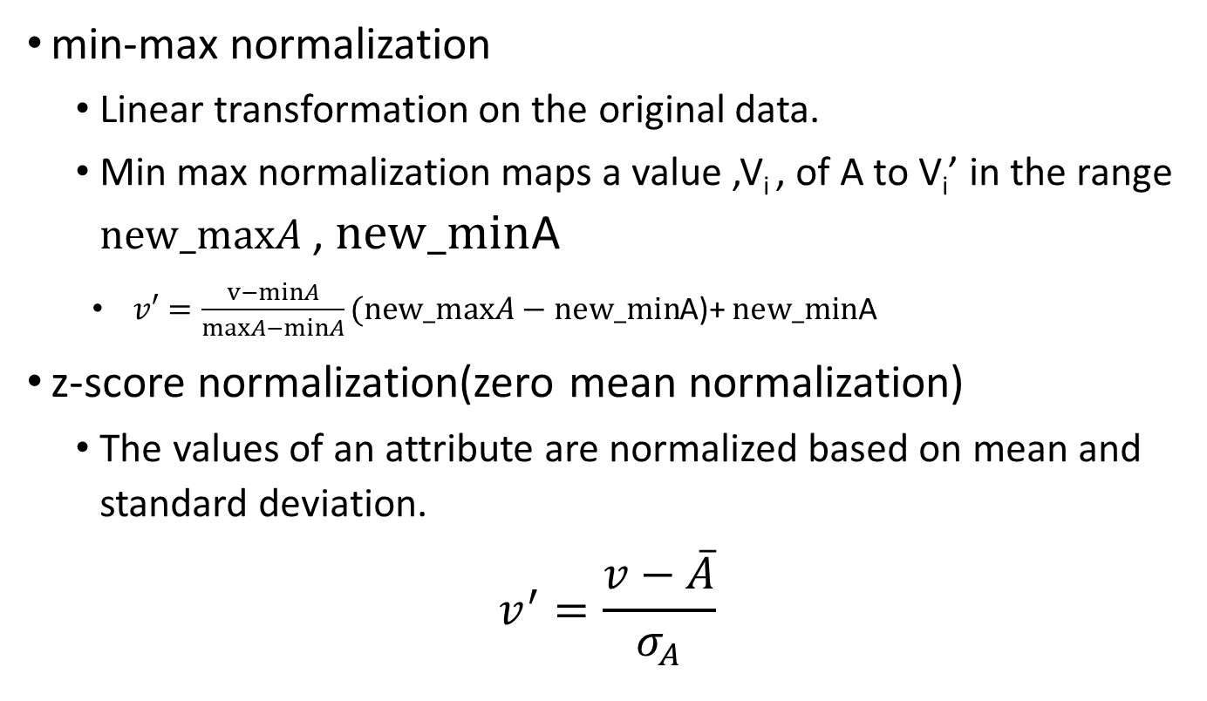
Data Transformation: Normalization
min-max normalization
Linear transformation on the original data.
Min max normalization maps a value ,V_{i} , of A to V_{i}’ in the range $new_maxA$ , $new_min$A
$v′=\frac{v−minA}{maxA−minA}(new_maxA−new_min$A)+ $new_min$A
z-score normalization(zero mean normalization)
The values of an attribute are normalized based on mean and standard deviation.
$$v^{′}=\frac{v−\overline{A}}{σ_{A}}$$

Slide 29

normalization by decimal scaling
Normalizes by moving the decimal point of values of attribute .
$v^{′}$= $v^{′}$/10j
Where j is the smallest integer such that Max(| |)<1

Slide 30
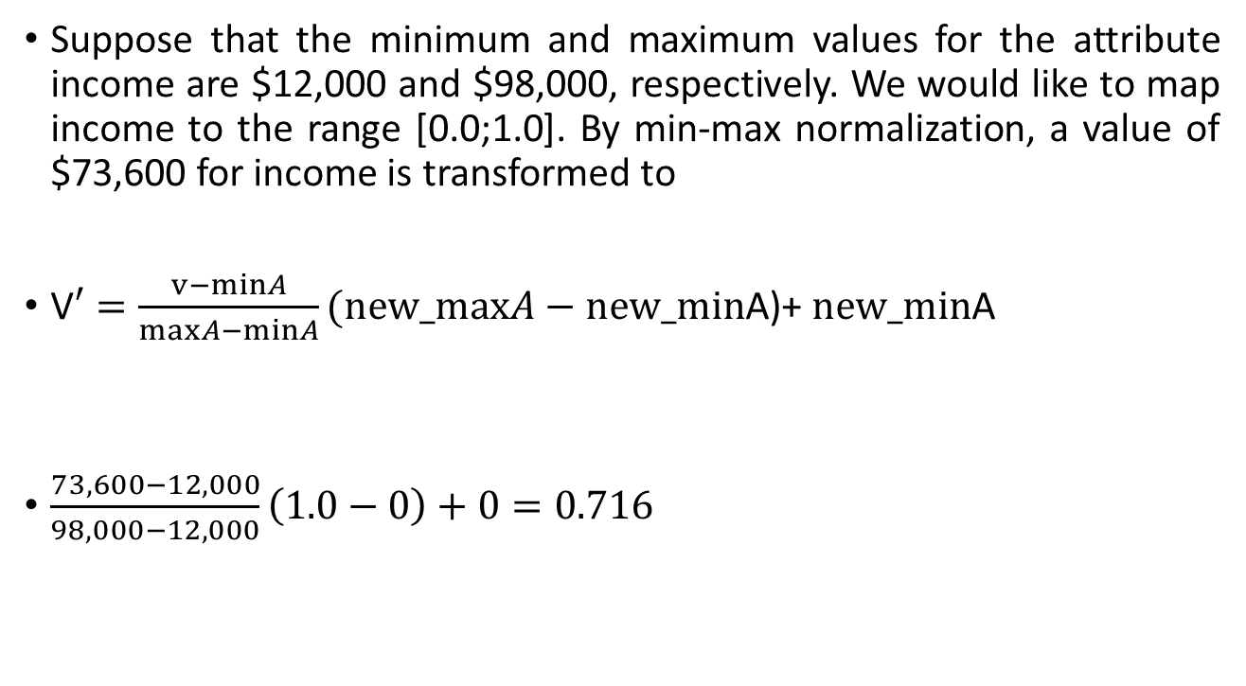
Min-max normalization Example
Suppose that the minimum and maximum values for the attribute income are $12,000 and $98,000, respectively. We would like to map income to the range [0.0;1.0]. By min-max normalization, a value of $73,600 for income is transformed to
V$′=\frac{v−minA}{maxA−minA}(new_maxA−new_min$A)+ $new_min$A
$\frac{73,600−12,000}{98,000−12,000}\left(1.0−0\right)+0=0.716$

Slide 31

z-score normalization Example
Suppose that the mean and standard deviation of the values for the attribute income are $54,000 and $16,000, respectively. With z-score normalization, a value of $73,600 for income is transformed to
$\frac{73,600−54,000}{16,000}=1.225$

Slide 32
Decimal scaling example
Suppose that the recorded values of A range from -986 to 917. The maximum absolute value of A is 986. To normalize by decimal scaling, we therefore divide each value by 1,000 (i.e., j = 3) so that -986 normalizes to -0.986 and 917 normalizes to 0.917.

Slide 33
University question
Use the two methods below to normalize the following group of data: 100,200,300,500,900
min-max normalization by setting min=0 and max=1
z-score normalization

Slide 34
Solution
Use the two methods below to normalize the following group of data: 100,200,300,500,900
min-max normalization by setting min=0 and max=1
Ans: 0, 0.125, 0.25, 0.5, 1

Slide 35
Solution
Use the two methods below to normalize the following group of data: 100,200,300,500,900
min-max normalization by setting min=0 and max=1
Ans: 0, 0.125, 0.25, 0.5, 1

Slide 36
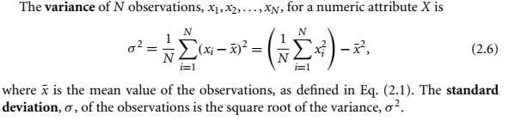

z-score normalization
$$v^{′}=\frac{vi−\overline{A}}{σ_{A}}$$

Slide 37
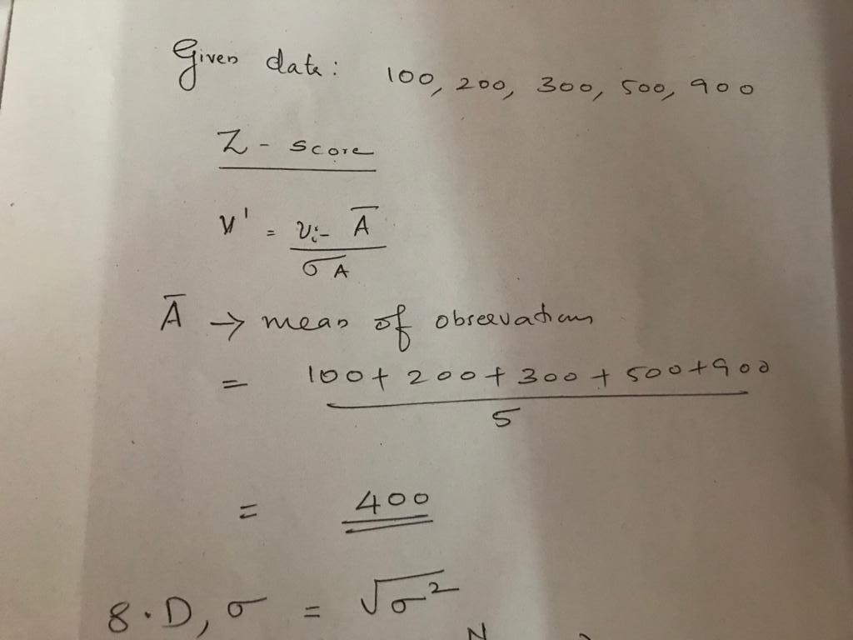

Slide 38
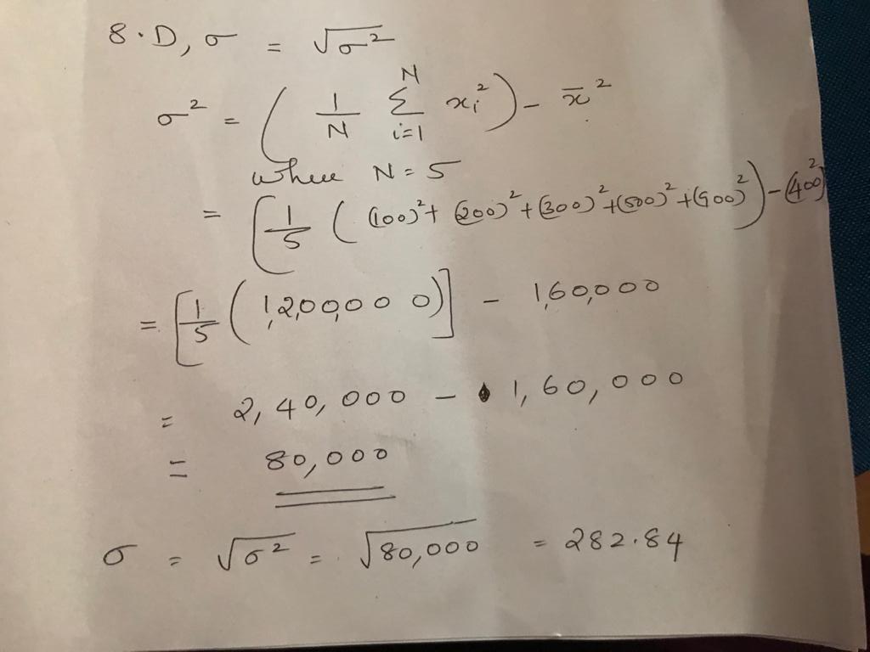

Slide 39
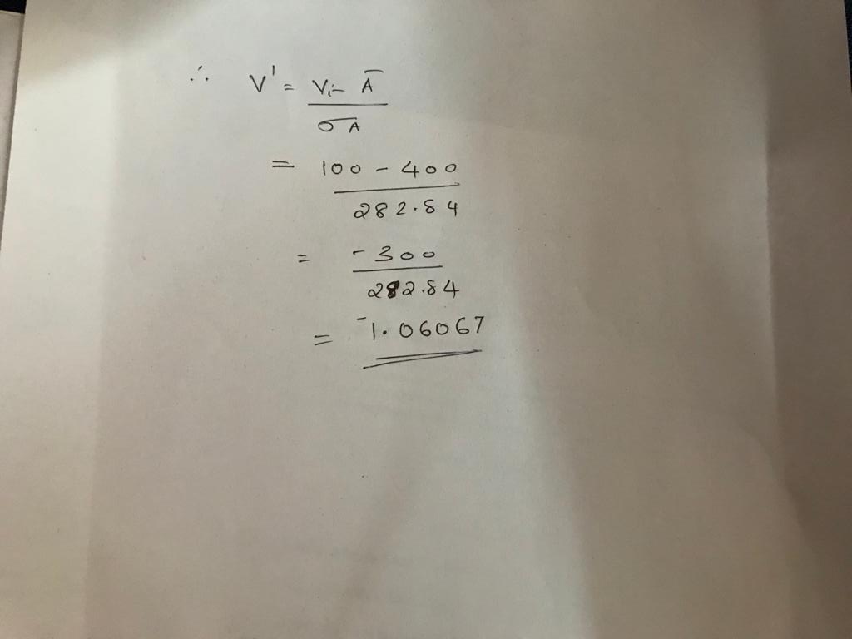

Slide 40
z-score normalization
-1.0607,-0.7071, -0.3536, 0.3536, 1.7678

Slide 41
calculate Z-Score of the following data?
marks
8
10
15
20

Slide 42
calculate Z-Score of the following data?- Solution
Mean = 13.25
Standard deviation = 5.37
marks | marks after z-score normalization
8 | -1.14
10 | -0.7
15 | 0.3
20 | 1.4

Slide 43
calculate Min Max normalization of the following data?
newMax: 1
newMin: 0
marks
8
10
15
20

Slide 44
calculate Min Max normalization of the following data? - Solution
marks | marks after Min-Max normalization
8 | 0
10 | 0.16
15 | 0.58
20 | 1

Slide 45
Module II
Data Preprocessing Concepts
Data Cleaning
Data integration and transformation
Data Reduction
Discretization and concept hierarchy.

Slide 46
Data Reduction Strategies
Why data reduction?
A database/data warehouse may store terabytes of data
Complex data analysis/mining may take a very long time to run on the complete data set
Data reduction
Obtain a reduced representation of the data set that is much smaller in volume but yet produce the same (or almost the same) analytical results

Slide 47
Data Reduction Strategies
Data reduction strategies
Data cube aggregation
Attribute subset selection
irrelevant, weakly relevant, or redundant attributes or dimensions may be detected and removed
Dimensionality reduction - e.g., remove unimportant attributes
Data Compression
Numerosity reduction - e.g., fit data into models
Discretization and concept hierarchy generation

Slide 48
Dimensionality Reduction
Curse of dimensionality
When dimensionality increases, data becomes increasingly sparse
Density and distance between points, which is critical to clustering, outlier analysis, becomes less meaningful
The possible combinations of subspaces will grow exponentially
Dimensionality reduction
Avoid the curse of dimensionality
Help eliminate irrelevant features and reduce noise
Reduce time and space required in data mining
Allow easier visualization
Dimensionality reduction techniques
Wavelet transforms
Principal Component Analysis

Slide 49
Wavelet Transforms
The Discrete Wavelet Transform (DWT) is a linear signal processing technique.
When applied to a data vector D, transforms it into a numerically different vector, D’, of wavelets coefficients .
All wavelet coefficients larger than some user defined threshold can be retained . The remaining coefficients set to zero.

Slide 50
Principal Components Analysis (PCA)
Suppose that the data to be reduced consist of tuples or data vectors described by n attributes or dimensions. Principal components analysis, or PCA searches for k n-dimensional orthogonal vectors that can best be used to represent the data, where k ≤ n.
The original data are thus projected onto a much smaller space, resulting in dimensionality reduction.
Unlike attribute subset selection, which reduces the attribute set size by retaining a subset of the initial set of attributes, PCA “combines” the essence of attributes by creating an alternative, smaller set of variables.

Slide 51
Attribute subset selection techniques
Why attribute subset selection?
Data sets for analysis may contain hundreds of attributes, many of which may be irrelevant to the mining task or redundant.
For example,
if the task is to classify customers as to whether or not they are likely to purchase a popular new CD at AllElectronics when notified of a sale, attributes such as the customer’s telephone number are likely to be irrelevant, unlike attributes such as age or music_taste.

Slide 52
Attribute subset selection techniques
Using domain expert to pick out some of the useful attributes
Sometimes this can be a difficult and time-consuming task, especially when the behaviour of the data is not well known
Leaving out relevant attributes or keeping irrelevant attributes result in discovered patterns of poor quality.
In addition, the added volume of irrelevant or redundant attributes can slow down the mining process.

Slide 53
Attribute subset selection techniques
Step-wise forward selection
Step-wise backward elimination
Combining forward selection and backward elimination
Decision-tree induction

Slide 55
Numerosity reduction
Numerosity reduction techniques replace the original data volume by alternative, smaller forms of data representation.
These techniques may be parametric or nonparametric.
For parametric methods, a model is used to estimate the data, so that typically only the data parameters need to be stored, instead of the actual data. (Outliers may also be stored.)
Regression and log-linear models are examples.
Nonparametric methods for storing reduced representations of the data include histograms , clustering, sampling and data cube aggregation

Slide 56
Parametric Data Reduction
Regression
Log-Linear Models

Slide 57
Regression Model
In linear regression, the data are modeled to fit a straight line
For example, a random variable, y (called a response variable), can be modeled as a linear function of another random variable, x (called a predictor variable), with the equation
Y = α+βx
x and y are numerical database attributes.
The coefficients, α and β (called regression coefficients), specify the Y-intercept and slope of the line respectively.
These coefficients can be solved for by the method of least squares

Slide 58
Regression Model
Multiple linear regression is an extension of (simple) linear regression,
which allows a response variable, y, to be modelled as a linear function of two or more predictor variables.

Slide 59
Log-linear models
Given a set of tuples in n dimensions (e.g., described by n attributes), we can consider each tuple as a point in an n-dimensional space.
Log-linear models can be used to estimate the probability of each point in a multidimensional space for a set of discretized attributes, based on a smaller subset of dimensional combinations.
This allows a higher-dimensional data space to be constructed from lower-dimensional spaces.

Slide 60
Non Parametric models
Histogram
Clustering
Data cube aggregation
sampling

Slide 61
Histograms
Histograms use binning to approximate data distributions and are a popular form of data reduction.
A histogram for an attribute, A, partitions the data distribution of A into disjoint subsets, or buckets.
If each bucket represents only a single attribute-value/frequency pair, the buckets are called singleton buckets.

Slide 62
Histograms
The following data are a list of prices of commonly sold items at AllElectronics (rounded to the nearest dollar).
The numbers have been sorted: 1, 1, 5, 5, 5, 5, 5, 8, 8, 10, 10, 10, 10, 12, 14, 14, 14, 15, 15, 15, 15, 15, 15, 18, 18, 18, 18, 18, 18, 18, 18, 20, 20, 20, 20, 20, 20, 20, 21, 21, 21, 21, 25, 25, 25, 25, 25, 28, 28, 30, 30, 30.

Slide 63
Histograms
A histogram for price using singleton buckets—each bucket represents one price-value/frequency pair.

Slide 64
Histograms
How are the buckets determined and the attribute values partitioned?” There are several partitioning rules, including the following:
Equal-width: In an equal-width histogram, the width of each bucket range is uniform
Equal-frequency (or equidepth): In an equal-frequency histogram, the buckets are created so that, roughly, the frequency of each bucket is constant(i.e ,each bucket contains roughly the same no of contiguous data samples.)

Slide 65
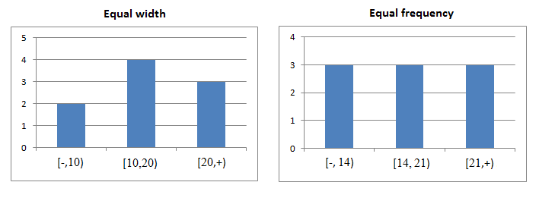
Histograms

Slide 66
Histograms
How are the buckets determined and the attribute values partitioned?” There are several partitioning rules, including the following:
V-Optimal: If we consider all of the possible histograms for a given number of buckets, the V-Optimal histogram is the one with the least variance.
Histogram variance is a weighted sum of the original values that each bucket represents, where bucket weight is equal to the number of values in the bucket.
MaxDiff: In a MaxDiff histogram, we consider the difference between each pair of adjacent values.
A bucket boundary is established between each pair for pairs having the β -1 largest differences, where β is the user-specified number of buckets.

Slide 67
Clustering
Clustering techniques consider data tuples as objects.
They partition the objects into groups or clusters, so that objects within a cluster are “similar” to one another and “dissimilar” to objects in other clusters.
The “quality” of a cluster may be represented by its diameter, the maximum distance between any two objects in the cluster.
Centroid distance is an alternative measure of cluster quality and is defined as the average distance of each cluster object from the cluster centroid

Slide 69
Clustering
In data reduction, the cluster representations of the data are used to replace the actual data.
The effectiveness of this technique depends on the nature of the data.

Slide 70
Sampling
Sampling can be used as a data reduction technique because it allows a large data set to be represented by a much smaller random sample (or subset) of the data.
Simple random sample without replacement (SRSWOR)
Simple random sample with replacement (SRSWR)
Cluster sample
Stratified sample

Slide 71
SRSWOR & SRSWR
SRSWOR
This is created by drawing s of the N tuples from D (s < N), where the probability of drawing any tuple in D is 1/N, that is, all tuples are equally likely to be sampled.
SRSWR
This is similar to SRSWOR, except that each time a tuple is drawn from D, it is recorded and then replaced.
That is, after a tuple is drawn, it is placed back in D so that it may be drawn again.

Slide 72
SRSWOR & SRSWR

Slide 73
Cluster sample
If the tuples in D are grouped into M mutually disjoint “clusters,” then an SRS of s clusters can be obtained, where s < M.

Slide 74
Stratified sample
If D is divided into mutually disjoint parts called strata, a stratified sample of D is generated by obtaining an SRS at each stratum

Slide 75
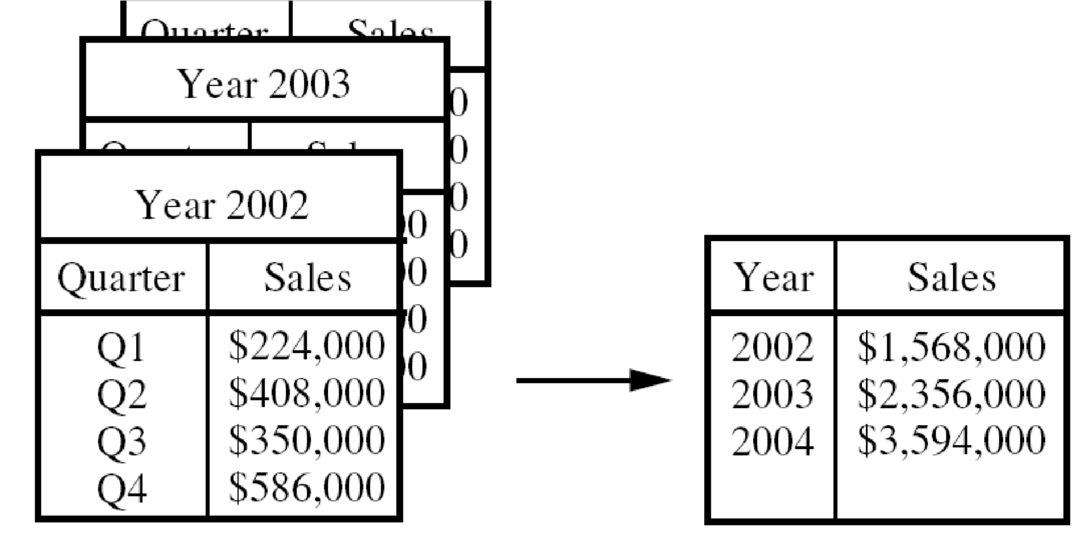
Data CUBE Aggregation
On the left, the sales are shown per quarter. On the right, the data are aggregated to provide the annual sales

Slide 76
Data compression
Data encoding or transformations are applied so as to obtain a reduced or compressed representation of original data
Lossless – with out any loss of information
Lossy – approximation of original data

Slide 77
Data Discretization and Concept Hierarchy Generation
Data discretization techniques can be used to reduce the number of values for a given continuous attribute by dividing the range of the attribute into intervals.
Interval labels can then be used to replace actual data values.
Replacing numerous values of a continuous attribute by a small number of interval labels thereby reduces and simplifies the original data.
This leads to a concise, easy-to-use, knowledge-level representation of mining results.

Slide 78
Data Discretization and Concept Hierarchy Generation
Discretization techniques can be categorized based on how the discretization is performed, such as whether it uses class information or which direction it proceeds (i.e., top-down vs. bottom-up).
If the discretization process uses class information, then we say it is supervised discretization. Otherwise, it is unsupervised
If the process starts by first finding one or a few points (called split points or cut points) to split the entire attribute range, and then repeats this recursively on the resulting intervals, it is called top-down discretization or splitting.

Slide 79
Data Discretization and Concept Hierarchy Generation
Bottom-up discretization or merging, which starts by considering all of the continuous values as potential split-points, removes some by merging neighborhood values to form intervals, and then recursively applies this process to the resulting intervals.

Slide 80
Data Discretization and Concept Hierarchy Generation

Slide 81
Discretization and Concept Hierarchy Generation for Numerical Data
Binning
Histogram analysis
Entropy-based discretization,
Chi-square merging
cluster analysis
discretization by intuitive partitioning.

Slide 82
Entropy-Based Discretization
Entropy is one of the most commonly used discretization measures.
Entropy-based discretization is a supervised, top-down splitting technique.
It explores class distribution information in its calculation and determination of split-points (data values for partitioning an attribute range).
To discretize a numerical attribute, A, the method selects the value of A that has the minimum entropy as a split-point, and recursively partitions the resulting intervals to arrive at a hierarchical discretization.

Slide 83
Entropy-Based Discretization
The basic method for entropy-based discretization of an attribute A within the set is as follows:
Each value of A can be considered as a potential interval boundary or split-point (denoted split point) to partition the range of A.
That is, a split-point for A can partition the tuples in D into two subsets satisfying the conditions A ≤split point and A > split point, respectively, thereby creating a binary discretization.
two classes, we would hope that all of the tuples of, say, class C1 will fall into one partition, and all of the tuples of class C2 will fall into the other partition.

Slide 84
Entropy-Based Discretization
where D1 and D2 correspond to the tuples in D satisfying the conditions A ≤ split point and A > split point, respectively; |D| is the number of tuples in D, and so on.
where pi is the probability of class Ci in D1
3. The process of determining a split-point is recursively applied to each partition obtained, until some stopping criterion is met

Slide 85
ChiMerge is a Chi Square-based discretization method
bottom-up approach by finding the best neighboring intervals and then merging these to form larger intervals, recursively.
The method is supervised in that it uses class information.

Slide 86
ChiMerge proceeds as follows.
Initially, each distinct value of a numerical attribute A is considered to be one interval.
Chi Square tests are performed for every pair of adjacent intervals.
Adjacent intervals with the least Chi Square values are merged together, because low Chi Square values for a pair indicate similar class distributions.
This merging process proceeds recursively until a predefined stopping criterion is met.

Slide 87
Discretization by Intuitive Partitioning
Although the above discretization methods are useful in the generation of numerical hierarchies, many users would like to see numerical ranges partitioned into relatively uniform, easy-to-read intervals that appear intuitive or “natural.”
For example, annual salaries broken into ranges like ($50,000, $60,000] are often more desirable than ranges like ($51,263.98, $60,872.34], obtained by, say, some sophisticated clustering analysis.

Slide 88
Concept Hierarchy Generation for Categorical Data
Specification of a partial ordering of attributes explicitly at the schema level by users or experts
Specification of a portion of a hierarchy by explicit data grouping
Specification of a set of attributes, but not of their partial ordering
Specification of only a partial set of attributes

